Slide 1


ENGINEERING CHEMISTRY
Dr. M. Veerabhadraswamy
Department of Science & Humanities,
Mobile no. 9241503423 e-mail: vbs@pes.edu

Slide 2

ENGINEERING CHEMISTRY
Module content:
Hydrogen Energy
Hydrogen Production methods
  Steam reforming
  Electrolysis of water
Hydrogen Storage
  Methods of Storage

Slide 3
ENGINEERING CHEMISTRY
Class content:
Hydrogen Energy
Hydrogen Production methods
  Steam Reforming
  Electrolysis of water

Slide 4
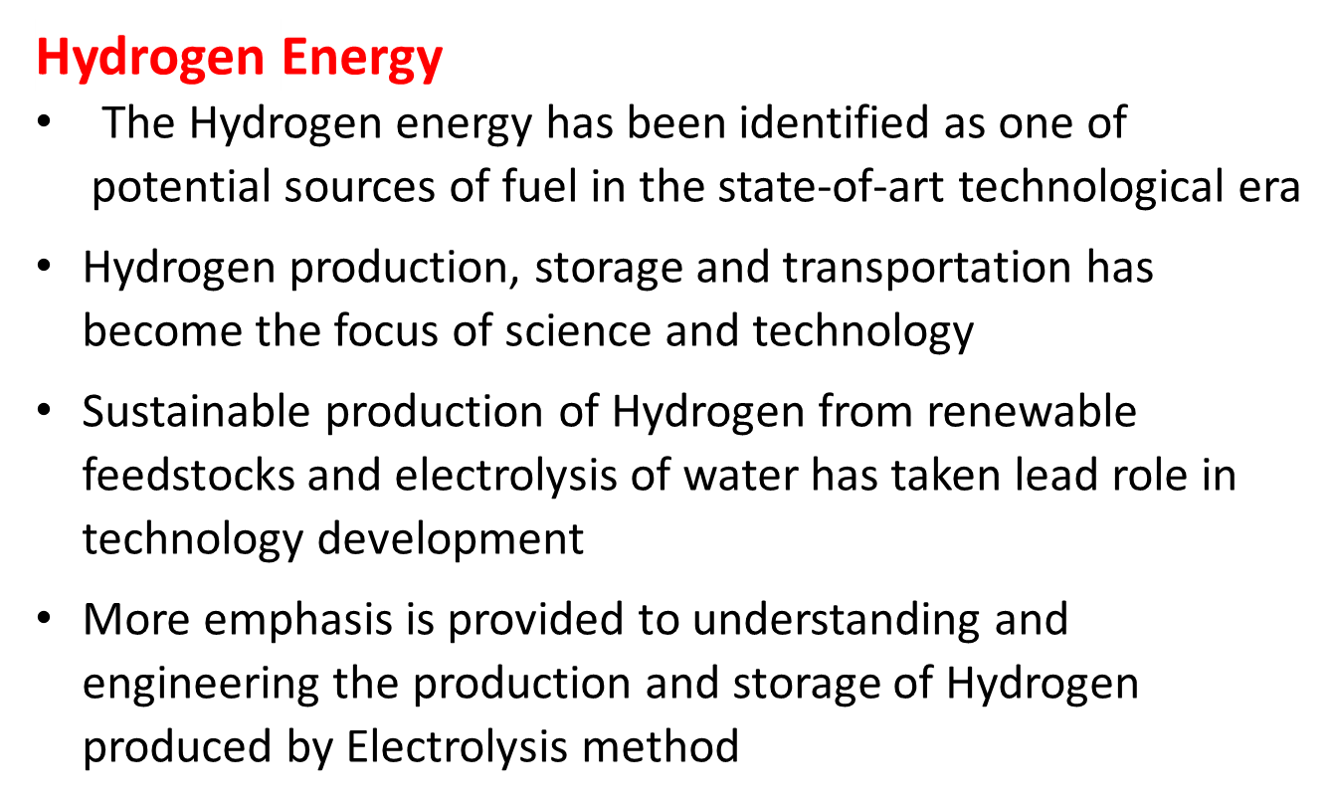
ENGINEERING CHEMISTRY

Slide 5
ENGINEERING CHEMISTRY
Advantages
Disadvantages
High cost
Highly flammable
It is still dependent on fossil fuels
Abundant availability in earth crust
Compatibility of hydrogen with fuel cell
High efficiency (65%) than diesel (45%) and gasoline (22%)

Slide 6
Hydrogen Economy
ENGINEERING CHEMISTRY
Hydrogen used as fuel reduces pollution
It is carbon free energy source
Hydrogen economy is a vision of an energy delivery infrastructure based on hydrogen as a carbon-free energy carrier
It provides
  alternative energy economy in the form of a parallel power and transportation infrastructure
  technical solutions for energy-efficient hydrogen production, storage technology and delivery infrastructure

Slide 7
ENGINEERING CHEMISTRY
Strategic Hydrogen production methods
Source
Feedstock
Processes
Natural Gas
Steam Reforming
Fossil fuel
Oil
Coal
Gasification
Biomass
Thermolysis
Pyrolysis
Electrolysis
Renewables
water

Slide 8
Hydrogen Production methods
ENGINEERING CHEMISTRY
Steam reforming (steam methane reforming –Grey Hydrogen)
  Natural gas is used to produce Hydrogen
  Most widespread process for generation of hydrogen
Gasification process (Black Hydrogen)
  Hydrogen is produced from coal by gasification process
  Coal is converted into CO₂ and subjected to gasification process to produce Carbon monoxide which is subjected to water gas shift process to produce mixture of CO₂and H₂ is purified to get pure H₂
Thermolysis (Green Hydrogen)
  involves thermochemical water splitting at high temperature 500ºC – 2000ºC to produce hydrogen
  carried in a closed system-the chemical used in the process are reused within each cycle consumed only water and produces hydrogen and oxygen

Slide 9
ENGINEERING CHEMISTRY
Photolysis
  Processes use light energy to split water into hydrogen and oxygen
  One of the potential for sustainable hydrogen production
  Low environmental impact
  Yet in early stage of research
Electrolysis
  uses electricity to split water into hydrogen and oxygen
  Electrolysis reaction takes place in a unit called an electrolyzer
  Method is promising option for carbon-free hydrogen production from renewable and nuclear resources.

Slide 10
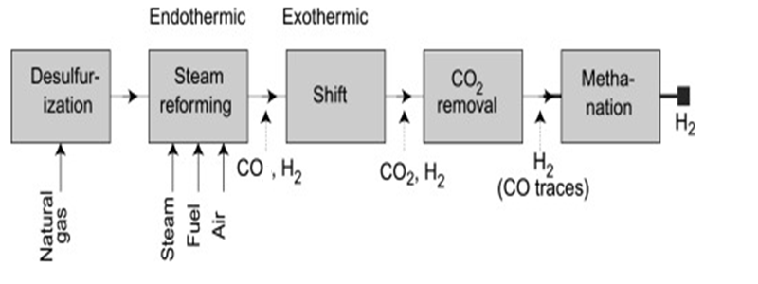
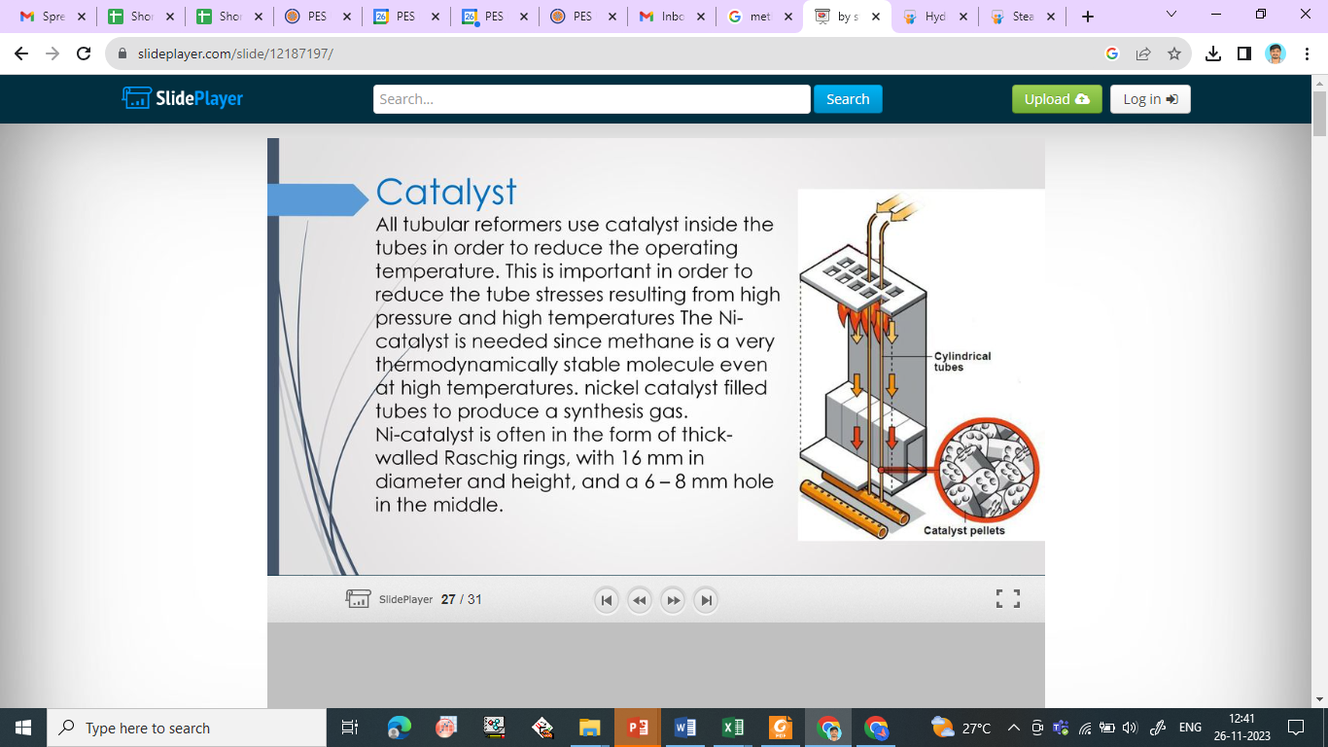
Steam reforming (Steam methane reforming)
ENGINEERING CHEMISTRY
Process involves four important steps
1. Desulphurization
  removal of sulphur form the feedstocks
  Sulphur tends to poison catalysts used in the
  steam reforming
2. Steam reforming
  Steam, fuel and air in the reform chamber in presence of catalyst form syngas
  CH₄ + H₂O → CO + 3 H₂
  850-900ºC
  Ni catalyst
  Endothermic reaction (ΔHº = +206 KJ/mole)
  High temperature and low pressure is favoured

Slide 11
ENGINEERING CHEMISTRY
3. Shift reforming (Water Gas shift reactions)
CO + H₂O → CO₂ + H₂
  Catalyst: Fe₃O₄/Cr₂O₃
  Exothermic reaction (ΔHº = -41.0 KJ/mole)
  Favoured at low temperature (350ºC)
  H₂ produced will have traces of Carbon monoxide as impurities
4. Purification
CO₂ is removed to product pure Hydrogen
Traces of CO is removed by methanation (350 – 450ºC)
  CO + 3H₂O → CH₄ + H₂O

Slide 12
Advantages and Limitations of Steam reforming method
ENGINEERING CHEMISTRY
Advantages
Limitations
General produces higher yield H₂ (50%)
Heat generated can be recycled to increase efficiency
Relatively stable during process
High level of carbonaceous materials are formed
External heat source is needed to initiate the reaction

Slide 13
ENGINEERING CHEMISTRY
Green Hydrogen production
Green Hydrogen refers to production of Hydrogen gas from renewable resources
Green Hydrogen production will help us reach both the momentum and promise for greener mobility and industry
Hydrogen production through Electrolysis produces clean energy with pollution free process by using electricity
Hydrogen production by electrolysis can be achieved by three methods.
Alkaline Electrolysis
Proton Membrane Electrolysis
High temperature Electrolysis

Slide 14
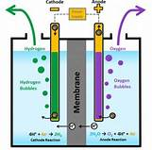
ENGINEERING CHEMISTRY
Module 6- Corrosion Chemistry
Working principles of Electrolysis of water:
When water is subjected to electrochemical process water molecules split in hydrogen and oxygen
Electricity is used for splitting the hydrogen and oxygen int their gaseous phase
Alkaline Electrolysis: Alkaline Process
The Hydrogen production by alkaline water electrolysis is one the environmentally friendly
Electrolysis of water
https://th.bing.com/th/id/OIP.y4cn6pR0TZFTSUf22XtXLgAAAA?pid=ImgDet&w=161&h=159&c=7

Slide 15
ENGINEERING CHEMISTRY
Zero emission of CO₂ (if this process combined with renewable energy sources like electricity form solar or wind energy)
Alkaline water electrolysis is conventional methods with easiest, simplest, and suitable methods for Hydrogen production
Electrolysis requires needs Direct current supply
Electrolyser split water into Hydrogen and Oxygen gas

Slide 16
ENGINEERING CHEMISTRY
Splitting of water is very small approximately 7- 10 moles/ litre
  because pure water is the very poor conductor of electricity hence acid (H₂SO₄ in acid electrolyzer) or base (KOH or NaOH in Alkaline electrolyzer) is used to improve the conductivity
Solutions split into ions which improving conductivity of the electrolyte.
The Reaction of water splitting is as follows:
  At Anode: 2OH⁻ → ½ O₂ + H₂O + 2 e⁻
  At Cathode: 2H₂O + 2e⁻ → H₂ + 2OH⁻
The basic equation of water splitting is represented as:
2H₂O _{(liquid)} + Energy -→ 2H₂(gas) + O₂ (gas)

Slide 17
ENGINEERING CHEMISTRY
ENGINEERING CHEMISTRY
In Alkaline electrolyte process
  aqueous solution containing either NaOH or KOH used
  typical concentration of 20-40 wt %
  operation temperatures are between 343 – 363 K
  operating pressure up to 3 MPa
Charge carrier: OH⁻
Anodic materials: Ni and its alloys
Cathodic materials: Cd, Pb, Cu, Ag, Pt, Pd.
Electrolyte materials : KOH, NaOH
Catalyst materials: Ni-Zn, Ni-Co-Au, RuO₂, LaCoO₃

Slide 18
Advantages and Limitations of Electrolysis process
ENGINEERING CHEMISTRY
Advantages
Limitations
No harmful emission produced
Clean hydrogen production
Results in zero greenhouse gas emission
Used in Fuel cells
Cost of production is high
Efficiency is low
Need high power source
Storage is challenge

Slide 19
ENGINEERING CHEMISTRY
Conclusion:
The Hydrogen energy has been identified as one of potential sources of fuel, Production of Green Hydrogen is the key focus to meet the sustainable development.
Hydrogen is not available as a pure gas, it must be produced from other compounds like fossil fuels, biomass, electrolysis, etc.,
Electrolysis of water to produce hydrogen is one of the most viable technology
Hydrogen evolution takes place at cathode materials, whereas oxygen evolves takes place at anode materials.
Catalysts improve the performance of the electrode materials to generate high and pure hydrogen gas.

Slide 20
THANK YOU
For any query contact: VBS
Dr. M. Veerabhadraswamy
Department of Science & Humanities,
e-mail: vbs@pes.edu, vsgswamy@yahoo.co.in
Mobile: +91 9241503423, 8310425312
https://scholar.google.co.in/citations?user=fkjyjv4AAAAJ&hl=en

